Slide 1


Computational Intelligence (TC2023)

Slide 2
Unit IV –Network Traffic Analysis (2)
Outline
Clustering Analysis
Decision-Tree

Slide 3

Clustering Analysis

Slide 4
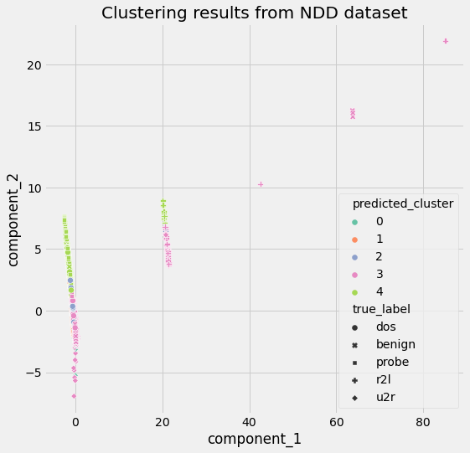

Slide 5
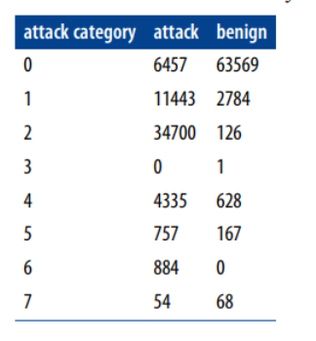
Clustering Analysis (Cross Tabulation)
Cross-tabulation, also known as cross-tab or contingency table, is a statistical tool used for categorical data. Categorical data involves values that are mutually exclusive to each other.

Slide 6
Clustering Analysis (Cross Tabulation)
clusters 2 and 6 have a very clear majority of attack traffic
clusters 3 and 7 seem to contain only low levels of noise
the rest of the clusters are quite mixed.

Slide 7
Clustering Analysis (Cross Tabulation)
For clusters that have an aggregate size of fewer than 200 samples, we consider them outliers and assign them the attack label.
For clusters with more than 99% of samples belonging to a single class (either attack or benign), we assign the dominant label to the entire cluster.
For each of the remaining clusters, we train a separate decision tree classifier.

Slide 8
Clustering Analysis (Cross Tabulation)
For clusters that have an aggregate size of fewer than 200 samples, we consider them outliers and assign them the attack label.
For clusters with more than 99% of samples belonging to a single class (either attack or benign), we assign the dominant label to the entire cluster.
For each of the remaining clusters, we train a separate decision tree classifier.

Slide 9
Clustering Analysis (Cross Tabulation)
Cluster 0: DECISION-TREE
Cluster 1: DECISION-TREE
Cluster 2: ATTACK
Cluster 3: Noise (ATTACK)
Cluster 4: DECISION-TREE
Cluster 5: DECISION-TREE
Cluster 6: ATTACK
Cluster 7: Noise (ATTACK)

Slide 10
Decision Tree

Slide 11
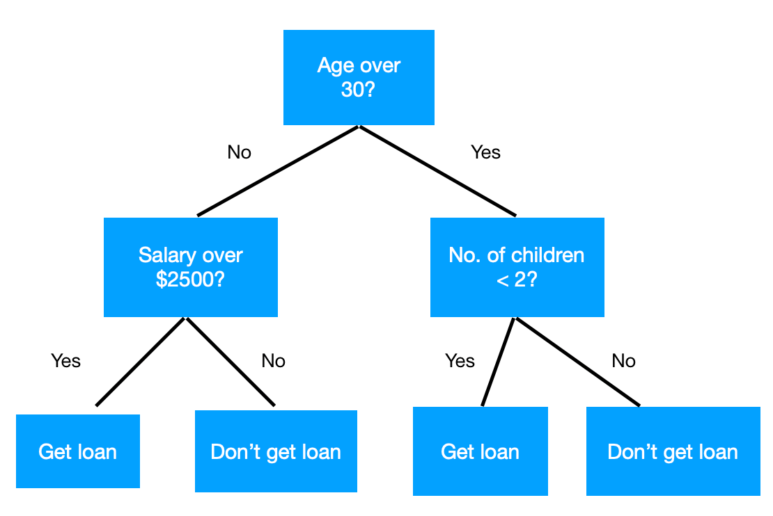
What is a Decision Tree?
A decision tree is a decision support tool that uses a tree-like model of decisions and their possible consequences, including chance event outcomes, resource costs, and utility.

Slide 12
What is a Decision Tree?
An inductive learning task: Use particular facts to make more generalized conclusions
A predictive model based on a branching series of Boolean tests: These smaller Boolean tests are less complex than a one-stage classifier

Slide 13
Predicting Commute Time
Leave At
If we leave at 10 AM and there are no cars stalled on the road, what will our commute time be?
10 AM
9 AM
8 AM
Stall?
Accident?
No
Yes
Long
No
Yes
Short
Long
Medium
Long

Slide 14
Inductive Learning
In this decision tree, we made a series of Boolean decisions and followed the corresponding branch
Did we leave at 10 AM?
Did a car stall on the road?
Is there an accident on the road?
By answering each of these yes/no questions, we then concluded on how long our commute might take

Slide 15
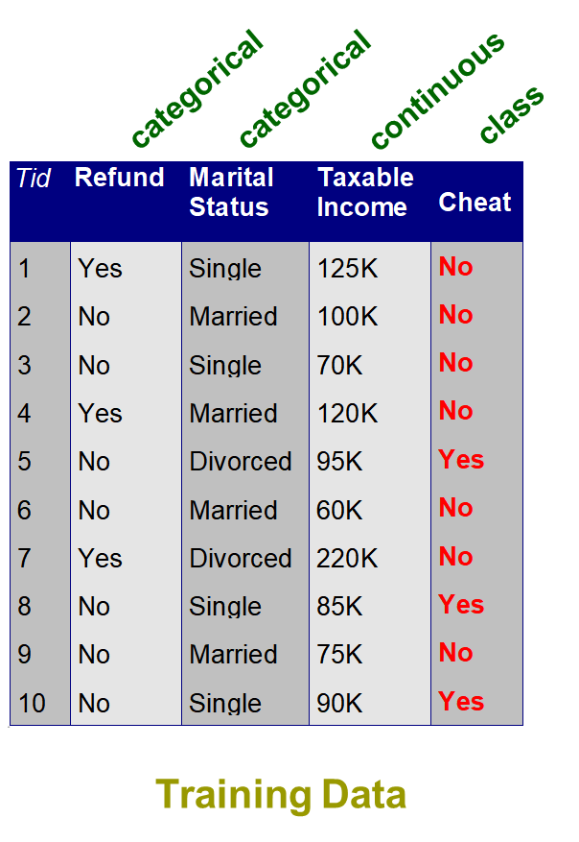
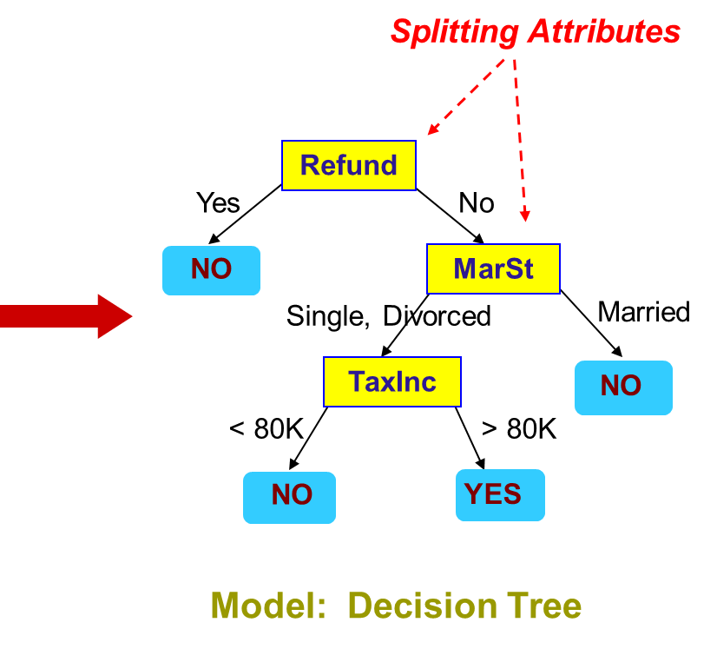

Slide 16
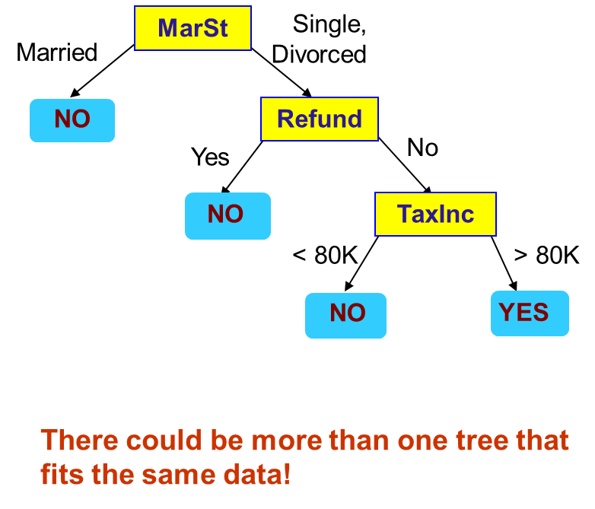

Slide 18
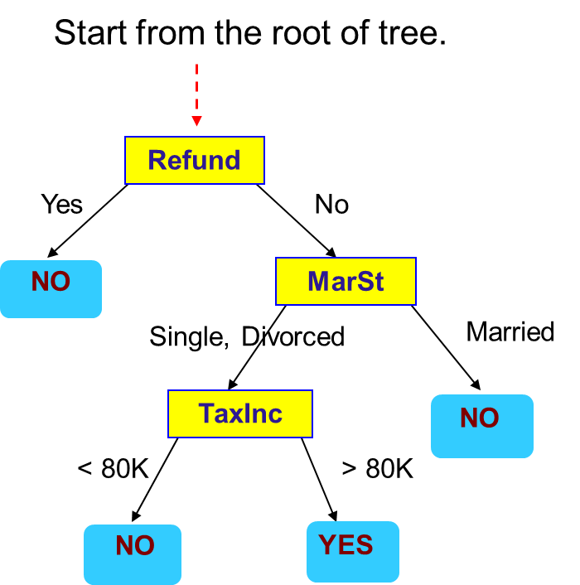
Evaluate Model
Test Data

Slide 19
Evaluate Model
Test Data
Refund
Yes
No
NO
MarSt
Single, Divorced
Married
TaxInc
NO
< 80K
> 80K
NO
YES

Slide 20
Evaluate Model
Test Data
Refund
Yes
No
NO
MarSt
Single, Divorced
Married
TaxInc
NO
< 80K
> 80K
NO
YES

Slide 21
Evaluate Model
Test Data
Refund
Yes
No
NO
MarSt
Single, Divorced
Married
TaxInc
NO
< 80K
> 80K
NO
YES

Slide 22
Evaluate Model
Test Data
Refund
Yes
No
NO
MarSt
Single, Divorced
Married
TaxInc
NO
< 80K
> 80K
NO
YES

Slide 23
Evaluate Model
Test Data
Refund
Yes
No
NO
MarSt
Single, Divorced
Married
Assign Cheat to “No”
TaxInc
NO
< 80K
> 80K
NO
YES
Notes:
Cheat = fraude

Slide 24
How to Create a Decision Tree
We first make a list of attributes that we can measure
These attributes (for now) must be discrete
We then choose a target attribute that we want to predict
Then create an experience table that lists what we have seen in the past

Slide 25
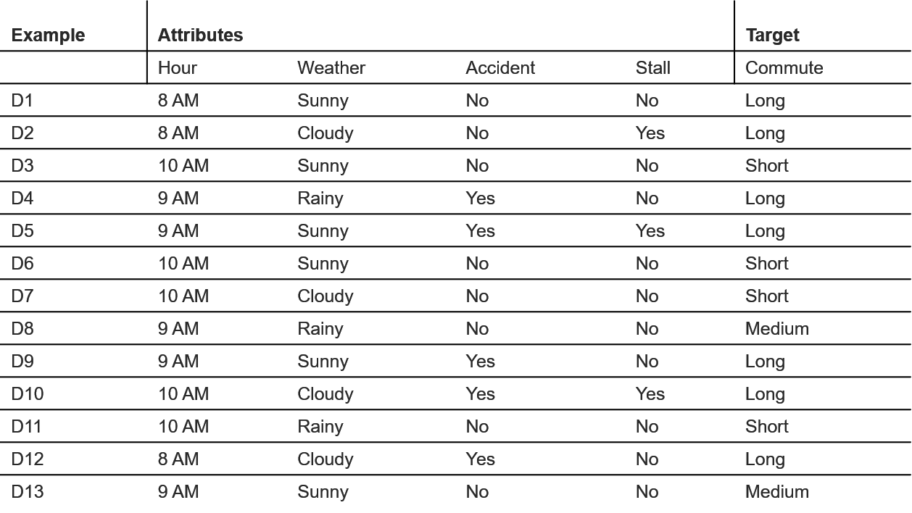

Slide 26
Predicting Commute Time
Leave At
If we leave at 10 AM and there are no cars stalled on the road, what will our commute time be?
10 AM
9 AM
8 AM
Stall?
Accident?
No
Yes
Long
No
Yes
Short
Long
Medium
Long

Slide 27
Choosing Attributes
The previous experience decision table showed 4 attributes: hour, weather, accident and stall
But the decision tree only showed 3 attributes: hour, accident and stall.
Why is that?

Slide 28
Choosing Attributes
Methods for selecting attributes (which will be described later) show that weather is not a discriminating attribute
We use the principle of Occam’s Razor: Given several competing hypotheses, the simplest one is preferable.

Slide 29
Choosing Attributes (ID3 Algorithm)
Choose the best attribute(s) to split the remaining instances and make that attribute a decision node
Repeat this process for recursively for each child
Stop when:
All the instances have the same target attribute value
There are no more attributes
There are no more instances

Slide 30
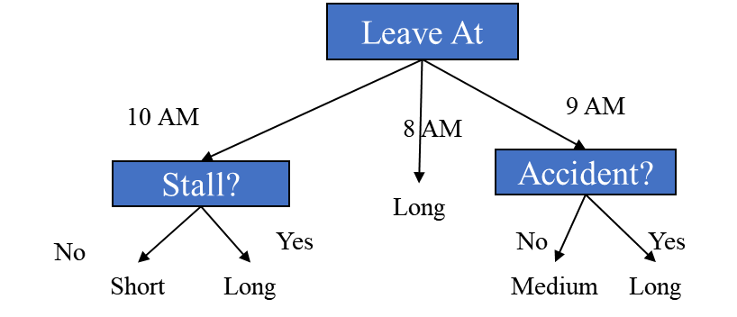
Identify the Best Attribute (ID3)
How did we know to split on leave at and then on stall and accident and not weather?

Slide 31
Identify the Best Attribute (ID3)
ID3 splits attributes based on their entropy.
Entropy is the measure of disinformation.

Slide 32
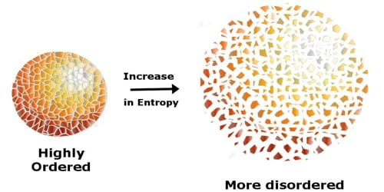
Identify the Best Attribute (ID3)
Entropy is minimized when all values of the target attribute are the same.
If we know that commute time will always be short, then entropy = 0
Entropy is maximized when there is an equal chance of all values for the target attribute (i.e. the result is random)
If commute time = short in 3 instances, medium in 3 instances and long in 3 instances, entropy is maximized

Slide 33
Identify the Best Attribute (ID3)
Entropy(S) = ∑_{(i=1 to l)}-|S_{i}|/|S| * log₂(|S_{i}|/|S|)
S = set of examples
S_{i} = subset of S with value v_{i} under the target attribute
l = size of the range of the target attribute

Slide 35
Predicting Commute Time
Leave At
If we leave at 10 AM and there are no cars stalled on the road, what will our commute time be?
10 AM
9 AM
8 AM
Stall?
Accident?
No
Yes
Long
No
Yes
Short
Long
Medium
Long

Slide 36
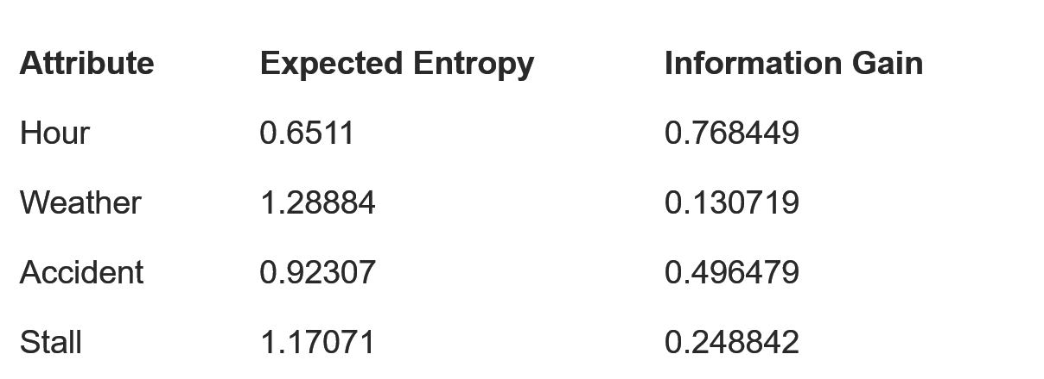
Identify the Best Attribute (ID3)
We can also measure information gain (which is inversely proportional to entropy).

Slide 37
Pruning Trees
There is another technique for reducing the number of attributes used in a tree - pruning
Two types of pruning:
Pre-pruning (forward pruning)
Post-pruning (backward pruning)

Slide 38
Prepruning
In prepruning, we decide during the building process when to stop adding attributes (possibly based on their information gain)
However, this may be problematic – Why?
Sometimes attributes individually do not contribute much to a decision, but combined, they may have a significant impact

Slide 39
Postpruning
Postpruning waits until the full decision tree has built and then prunes the attributes
Two techniques:
Subtree Replacement
Subtree Raising

Slide 40
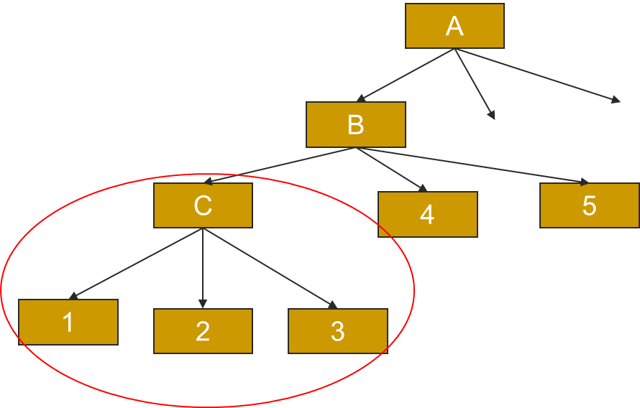
Subtree Replacement
Entire subtree is replaced by a single leaf node.

Slide 41
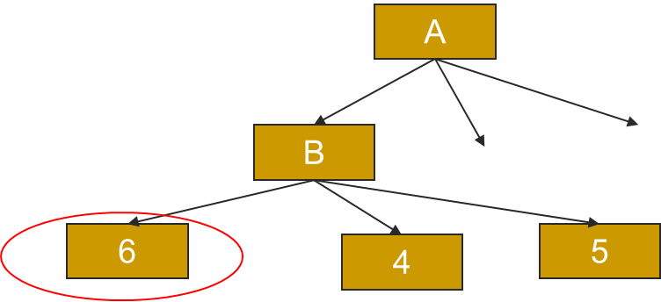
Subtree Replacement
Node 6 replaced the subtree
Generalizes tree a little more but may increase accuracy.

Slide 42
Subtree Raising
Entire subtree is raised onto another node.

Slide 43
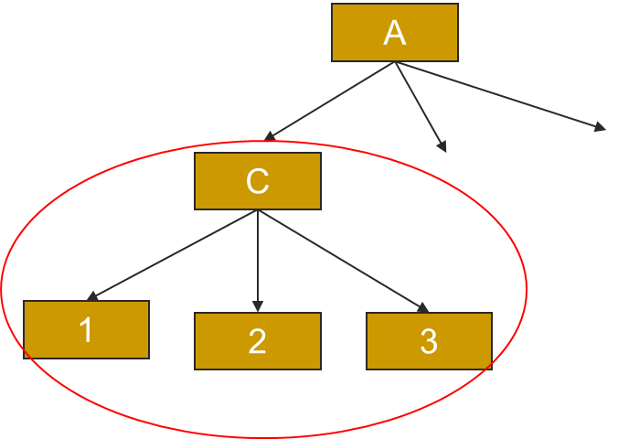
Subtree Raising
Entire subtree is raised onto another node.
This was not discussed in detail as it is not clear whether this is worthwhile (as it is very time consuming).

Slide 44
ID3 Problems
ID3 is not optimal
Uses expected entropy reduction, not actual reduction
Must use discrete (or discretized) attributes
What if we left for work at 9:30 AM?
We could break down the attributes into smaller values…

Slide 45
ID3 Problems (Error Propagation)
Since decision trees work by a series of local decisions, what happens when one of these local decisions is wrong?
Every decision from that point on may be wrong
We may never return to the correct path of the tree

Slide 46
Unit IV –Network Traffic Analysis (2)
Outline
Clustering Analysis
Decision-Tree

Slide 47
Computational Intelligence (TC2023)

